Slide 1
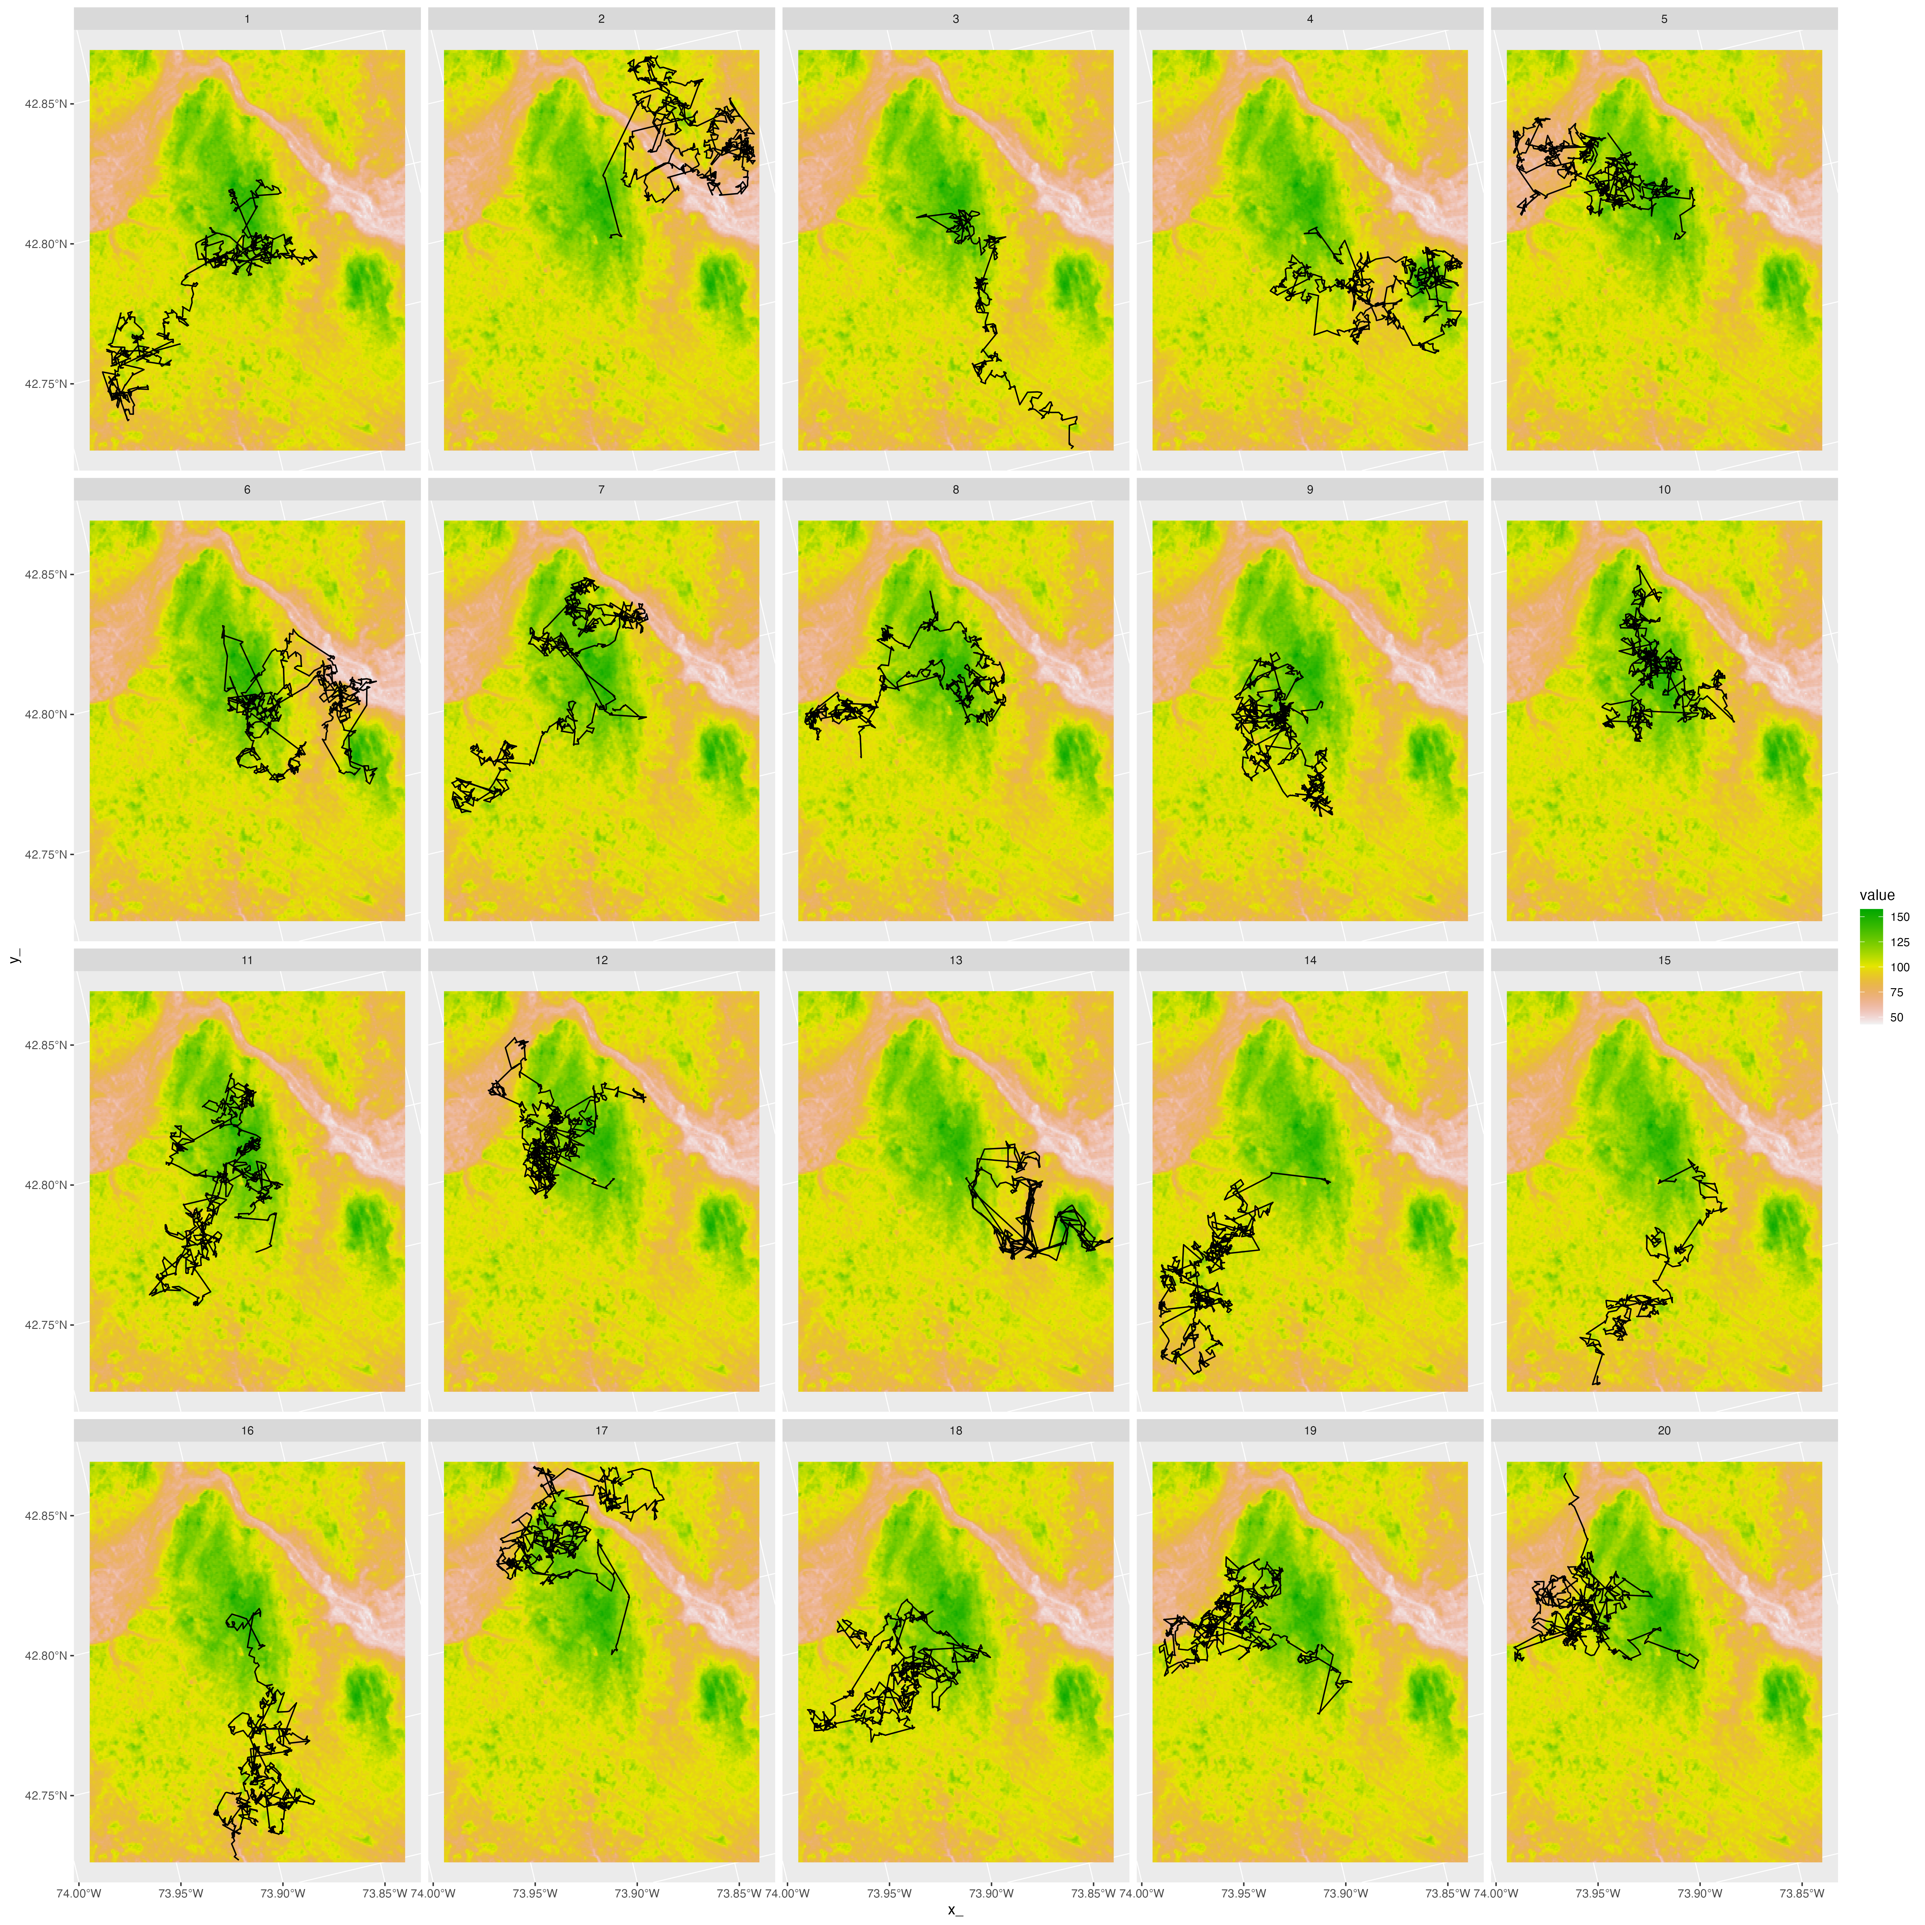
Evaluating Goodness-of-fit of Animal Movement Models Using Lineups
John Fieberg¹, Johannes Signer², Smith Freeman¹
¹ Department of Fisheries, Wildlife, and Conservation Biology, University of Minnesota
² Wildlife Sciences, University of Goettingen

Slide 2
Evaluating Goodness-of-fit of Integrated Step-Selection Analyses and Hidden Markov Models Using Lineups
John Fieberg¹, Johannes Signer², Smith Freeman¹
¹ Department of Fisheries, Wildlife, and Conservation Biology, University of Minnesota
² Wildlife Sciences, University of Goettingen

Slide 3
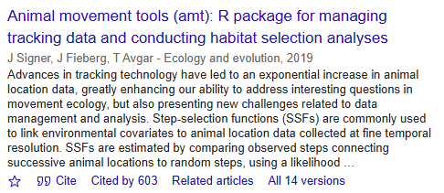
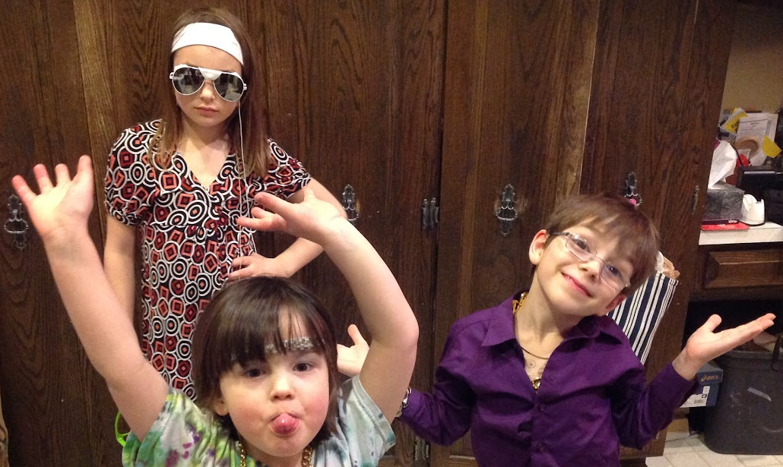
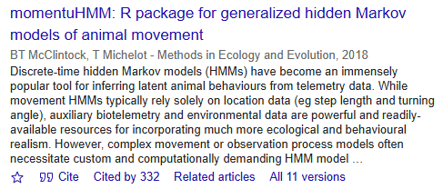
Movement Ecology
Zoe, Ray, and Caroline Fieberg (about 10 years ago!)

Slide 4


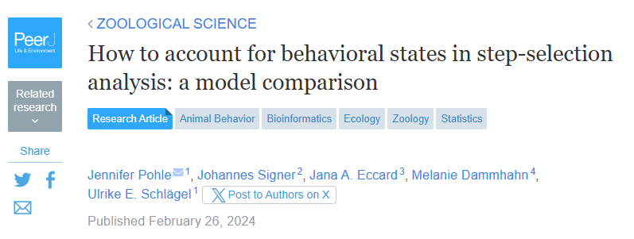
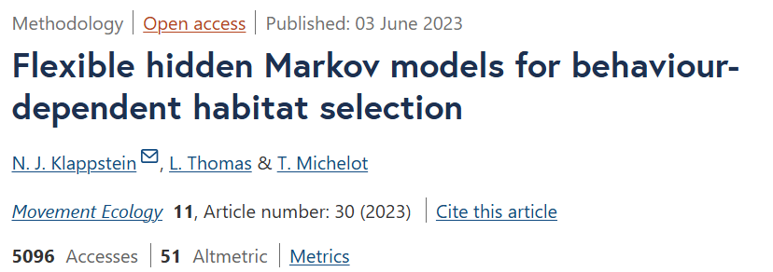
Movement Ecology

Slide 5
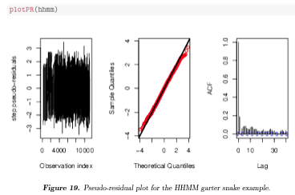

How Good is Our Model?
momuntuHMM includes functions for plotting pseudo-residuals
amt now includes functions for creating used-habitat calibration plots via cross-validation
Compares distribution of environmental covariates at observed locations to covariates at locations predicted to be used by the model.
“One-step-ahead” predictions
Goodness-of-fit tests using simulated trajectories from fitted models.
Fieberg, J. R., Forester, J. D., Street, G. M., Johnson, D. H., ArchMiller, A. A., & Matthiopoulos, J. (2018). Used‐habitat calibration plots: A new procedure for validating species distribution, resource selection, and step‐selection models. Ecography, 41(5), 737-752.

Slide 6

Lineup Protocol
Simulate n data sets from the fitted model.
Combine each of the data sets with the observed data.
Create a random index for the location of the observed data in a multi-panel plot.
See if the observed data stand out in some way.

Slide 7

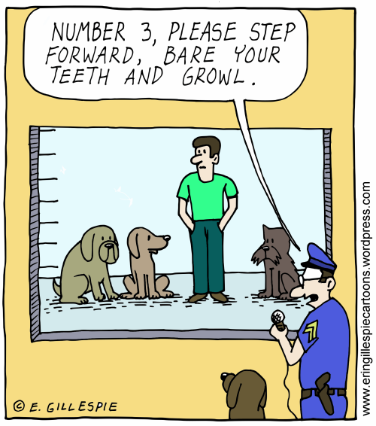
Lineup Protocol

Slide 8
Lineup Goodness-of-fit test
H₀: The observed data are consistent with the fitted model.
H_{A}: The observed data are NOT consistent with the fitted model.
Test statistic = a plot of the real data!
Sampling distribution | H₀ = plots using simulated trajectories from the fitted (i.e., null) model.

Slide 9
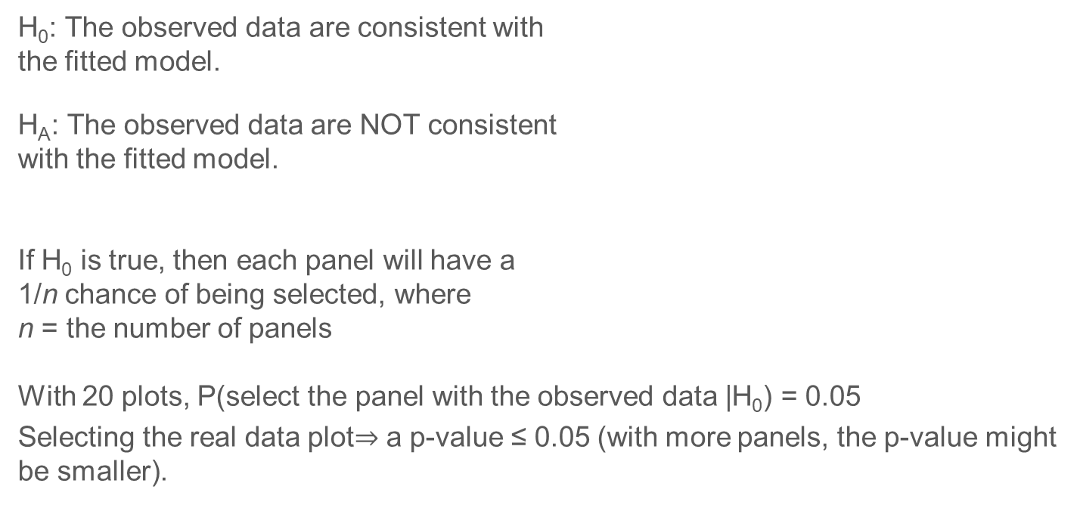
Lineup Goodness-of-fit test
H₀: The observed data are consistent with the fitted model.
H_{A}: The observed data are NOT consistent with the fitted model.
If H₀ is true, then each panel will have a 1/n chance of being selected, where n = the number of panels
With 20 plots, P(select the panel with the observed data |H₀) = 0.05
Selecting the real data plot$⇒$ a p-value ≤ 0.05 (with more panels, the p-value might be smaller).

Slide 10
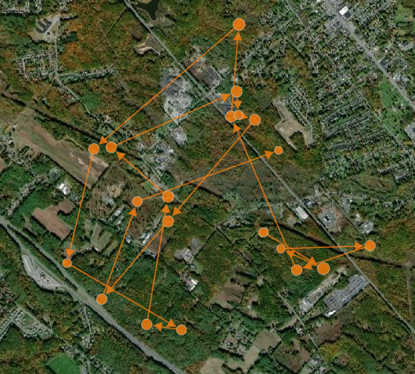
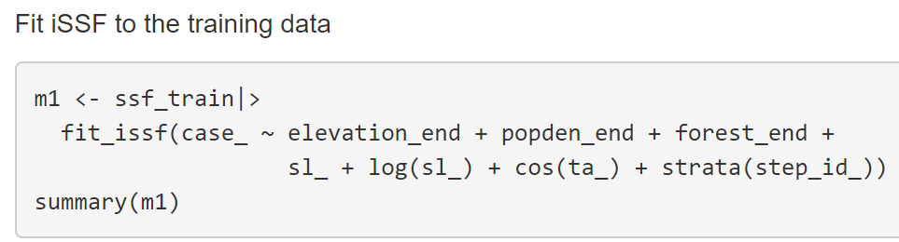
ISSA
Integrated step-selection analysis of fisher data (Lapoint et al. 2013).
Predictors:
Landcover class (forest or not)
Human Population Density
Elevation
LaPoint, S., Gallery, P., Wikelski, M., & Kays, R. (2013b). Data from: Animal behavior, cost- based corridor models, and real corridors. Movebank Data Repository. Retrieved from https://doi. org/10.5441/001/1.2tp2j43g

Slide 11
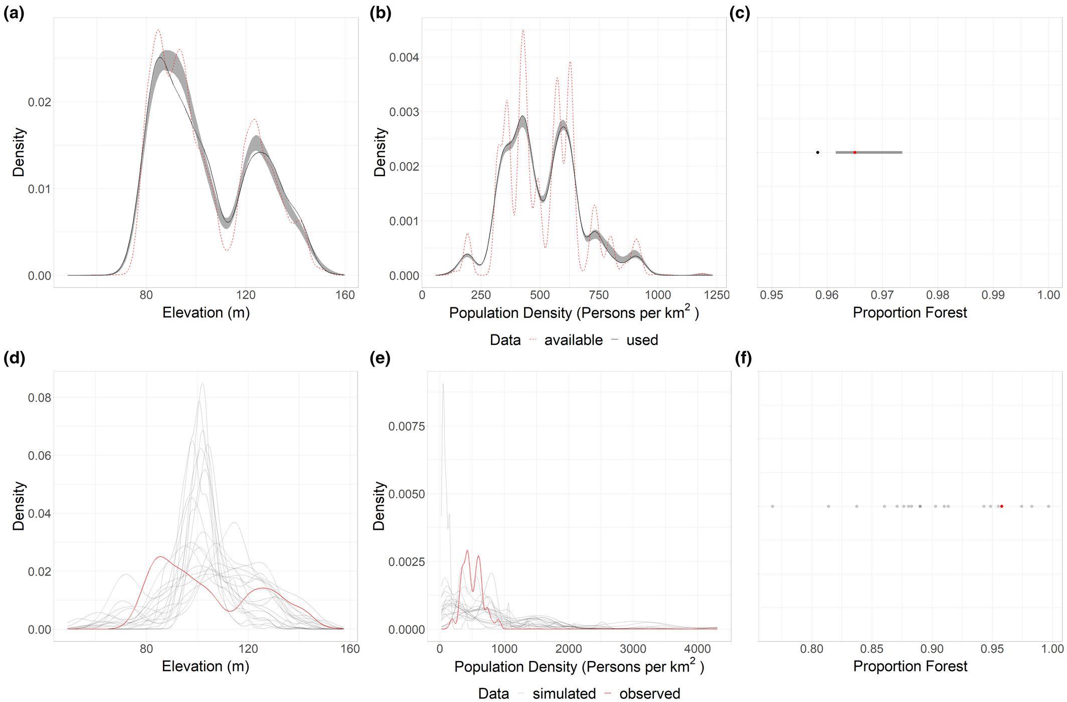
Summarize simulated trajectories
Used-habitat calibration plots (top row)
Trajectory summaries (bottom rown)
Training data (2 fisher)
Test data (1 held out fisher)

Slide 12
ISSA

Slide 13
ISSA

Slide 14
ISSA

Slide 15
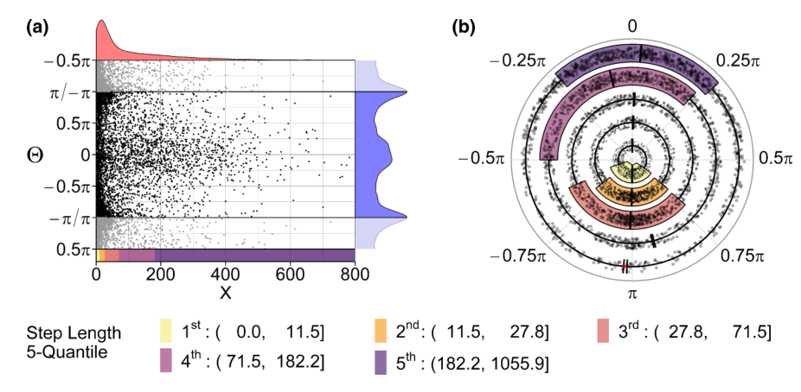
Correlation between step-lengths and turn angles
Hodel, F. H., & Fieberg, J. R. (2022). Circular–linear copulae for animal movement data. Methods in Ecology and Evolution, 13(5), 1001-1013.

Slide 16
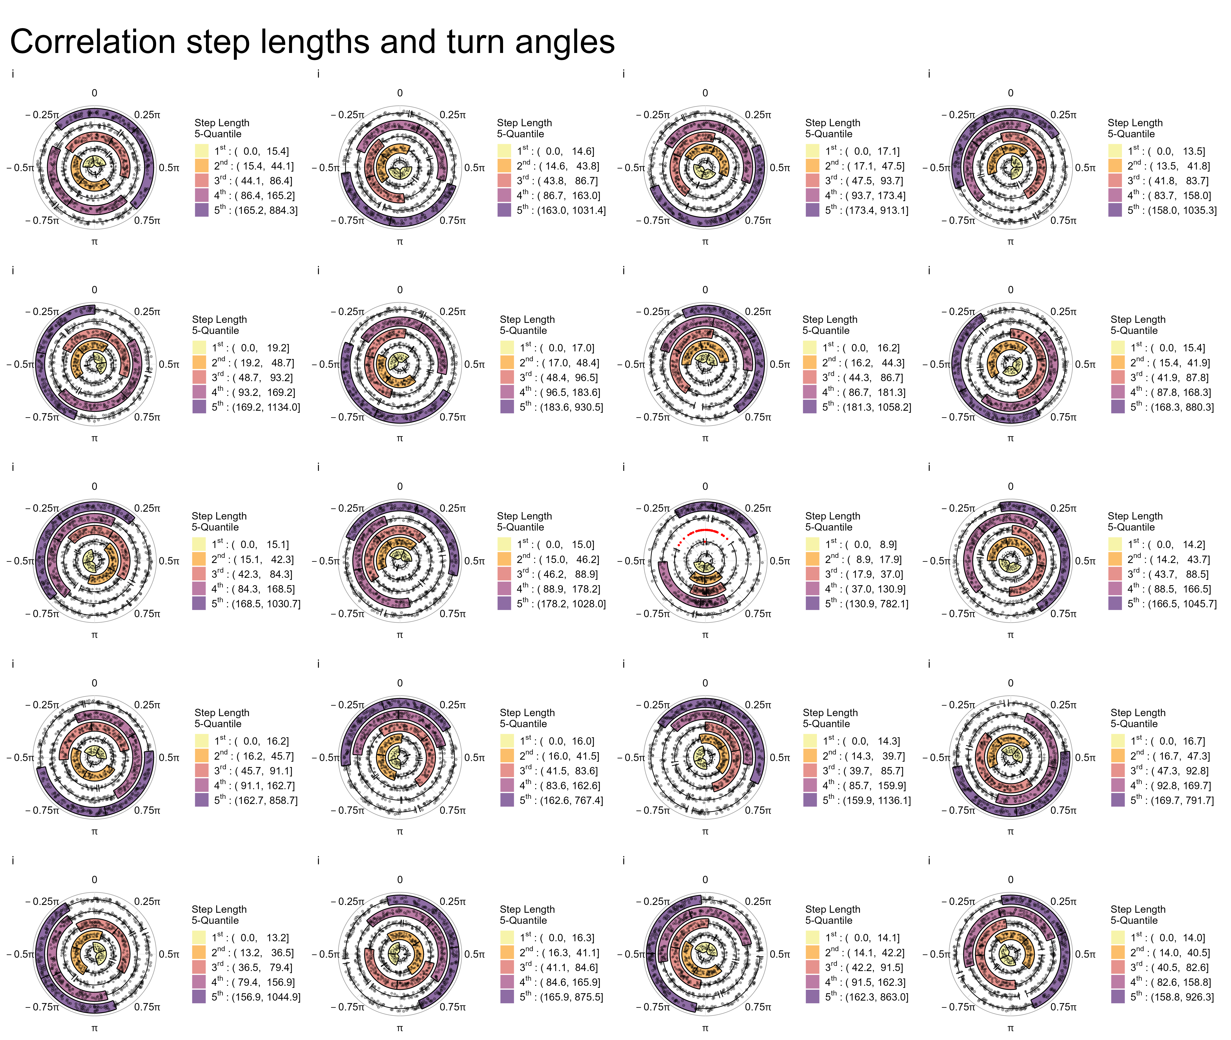

Slide 17
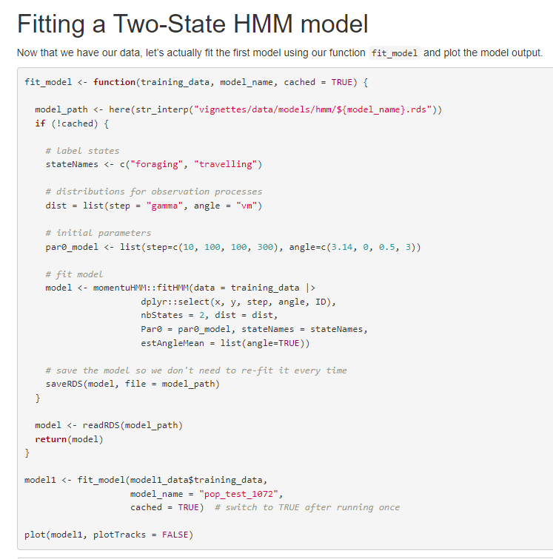
Hidden Markov Model
Two states (foraging and traveling)
State-dependent step-length and turn-angle distributions:
Step length ~ Gamma
Turn Angle ~ von Mises

Slide 18
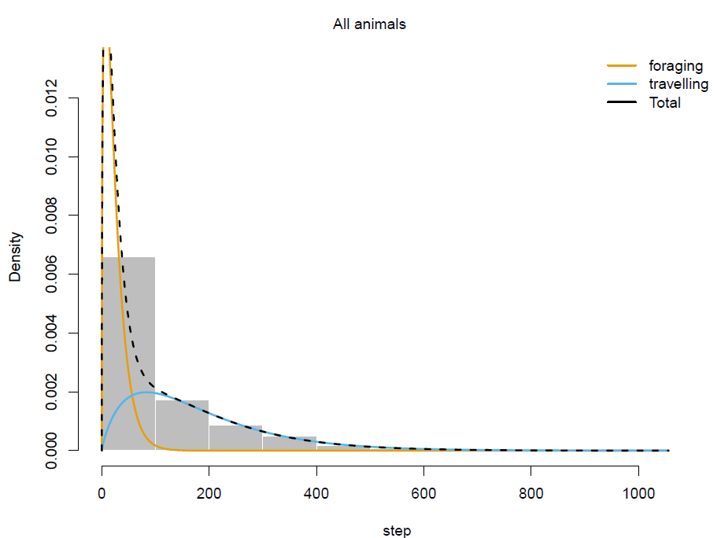
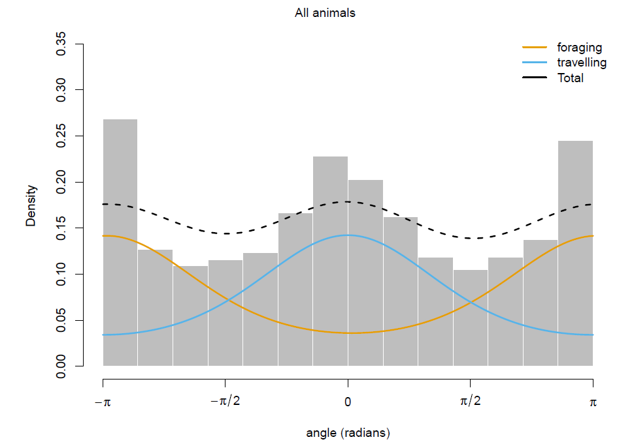
Hidden Markov Models (HMM)

Slide 19
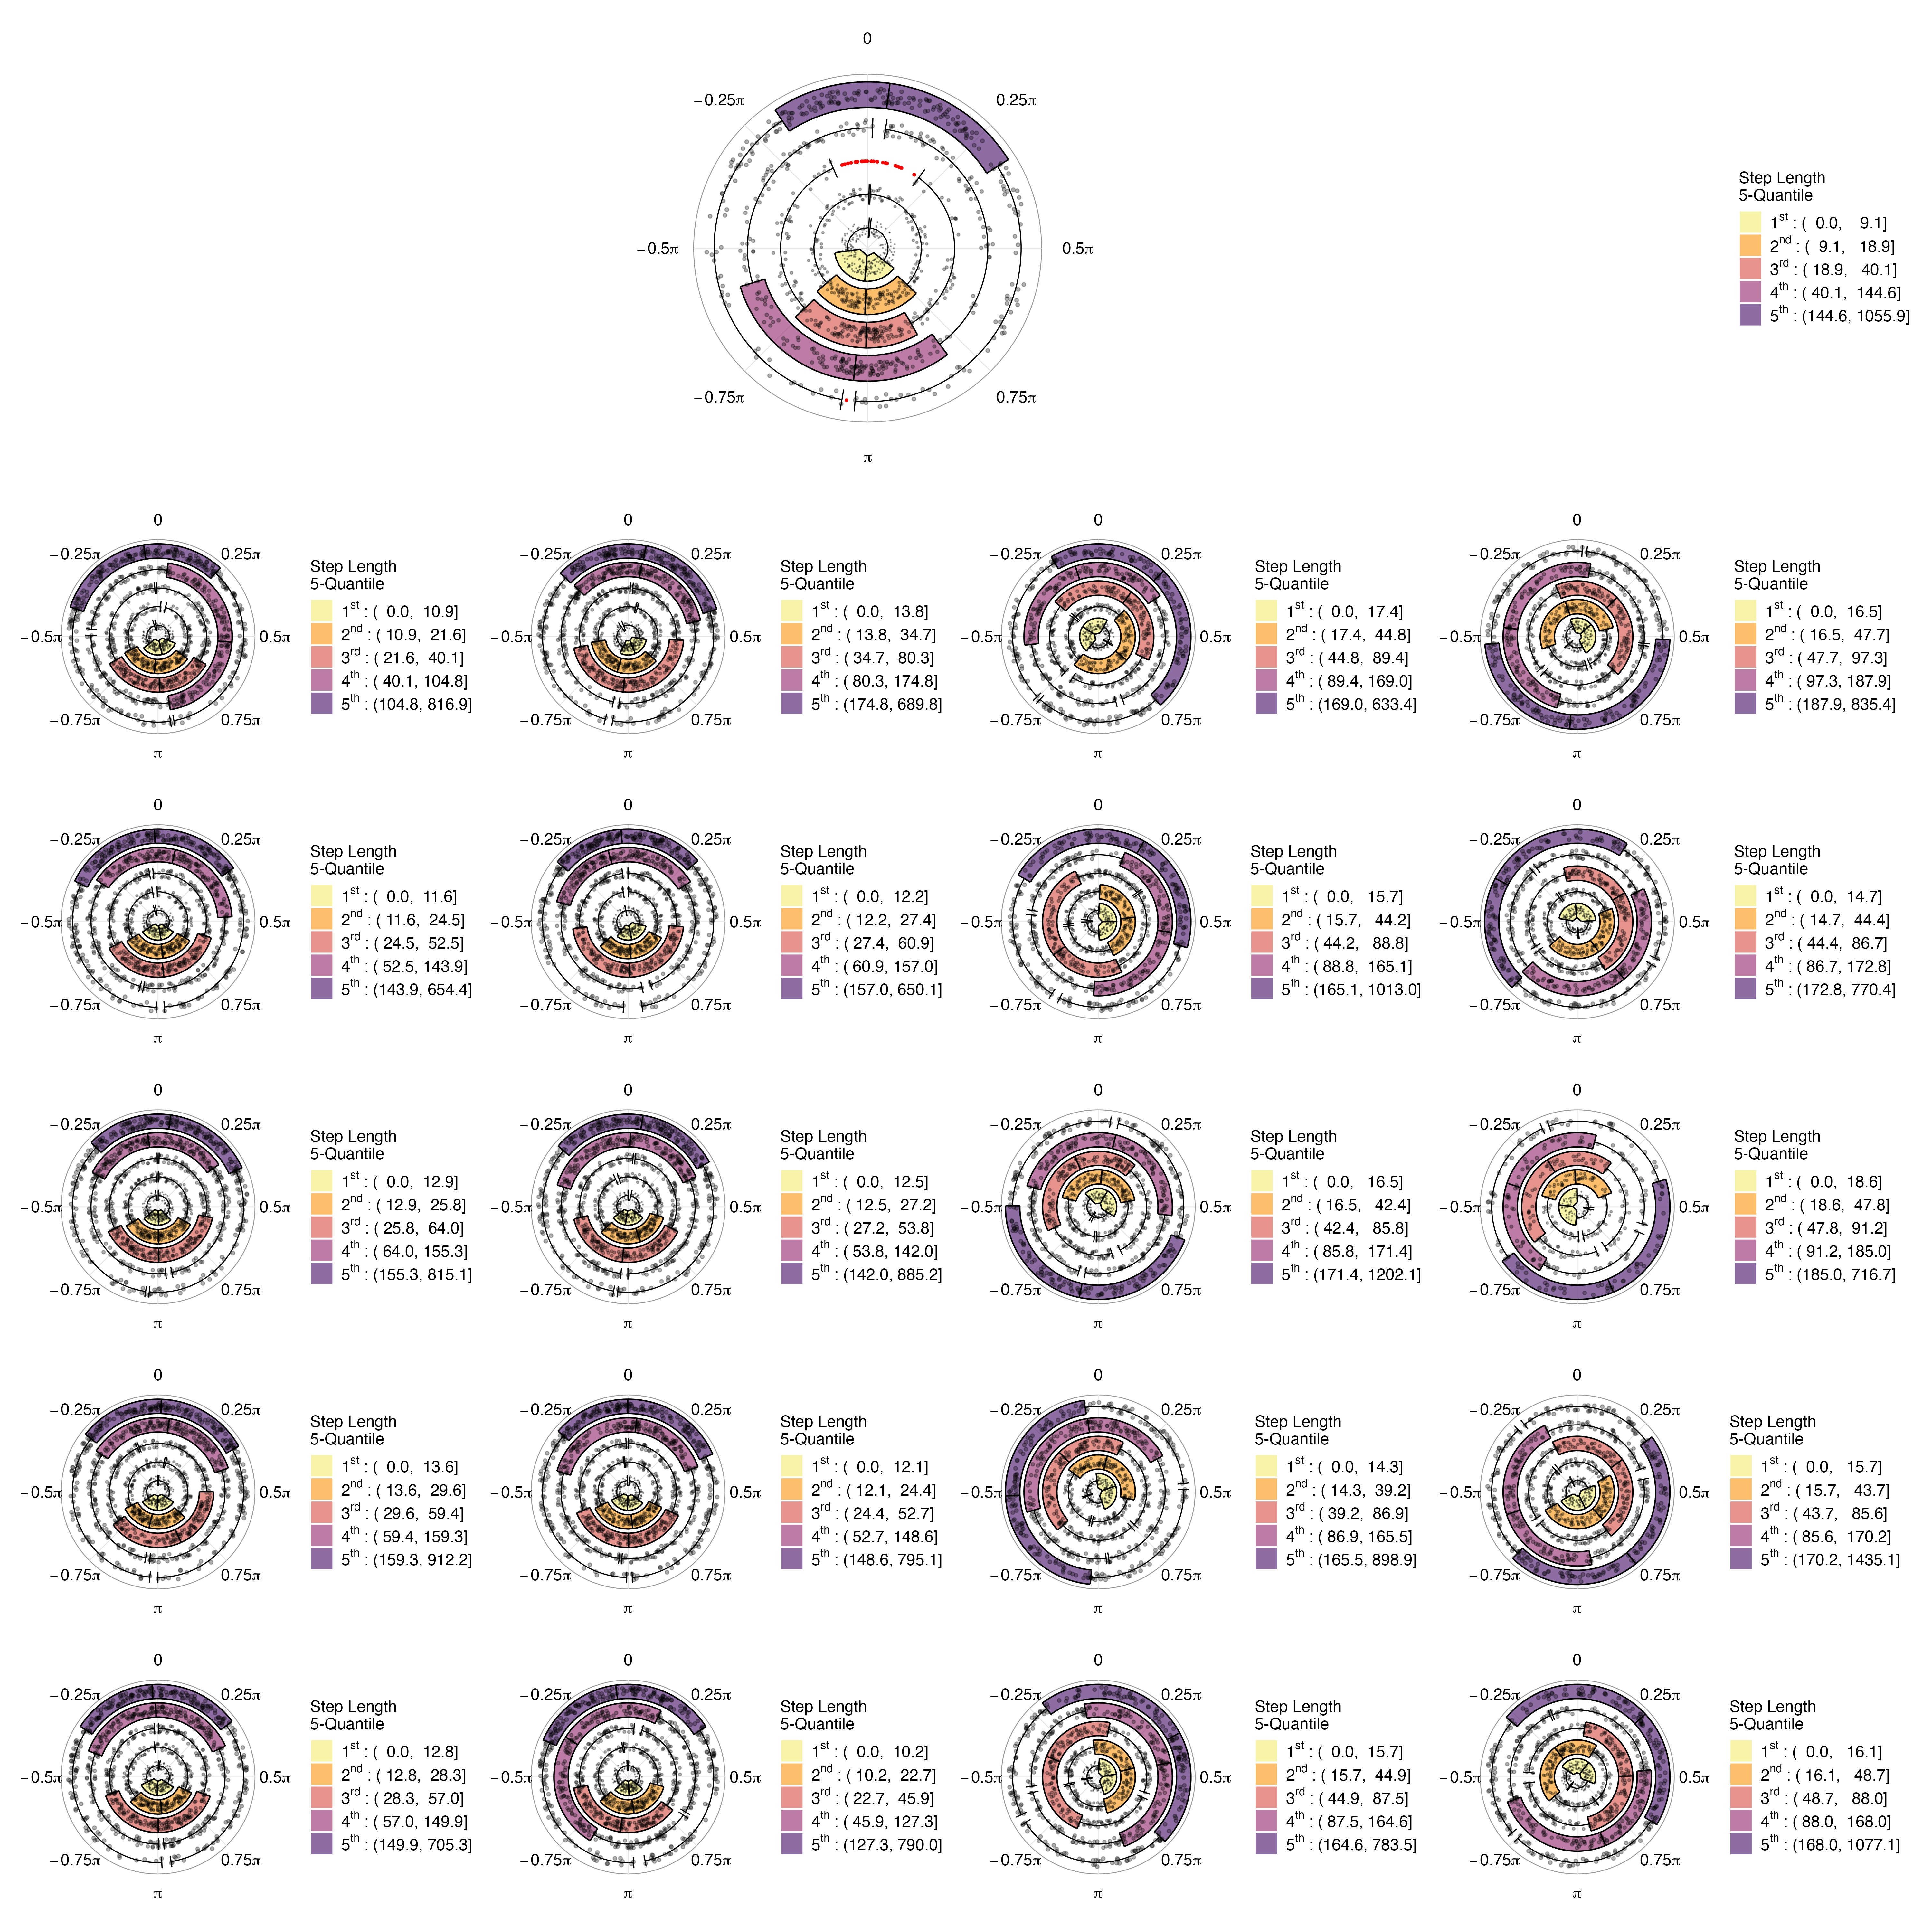
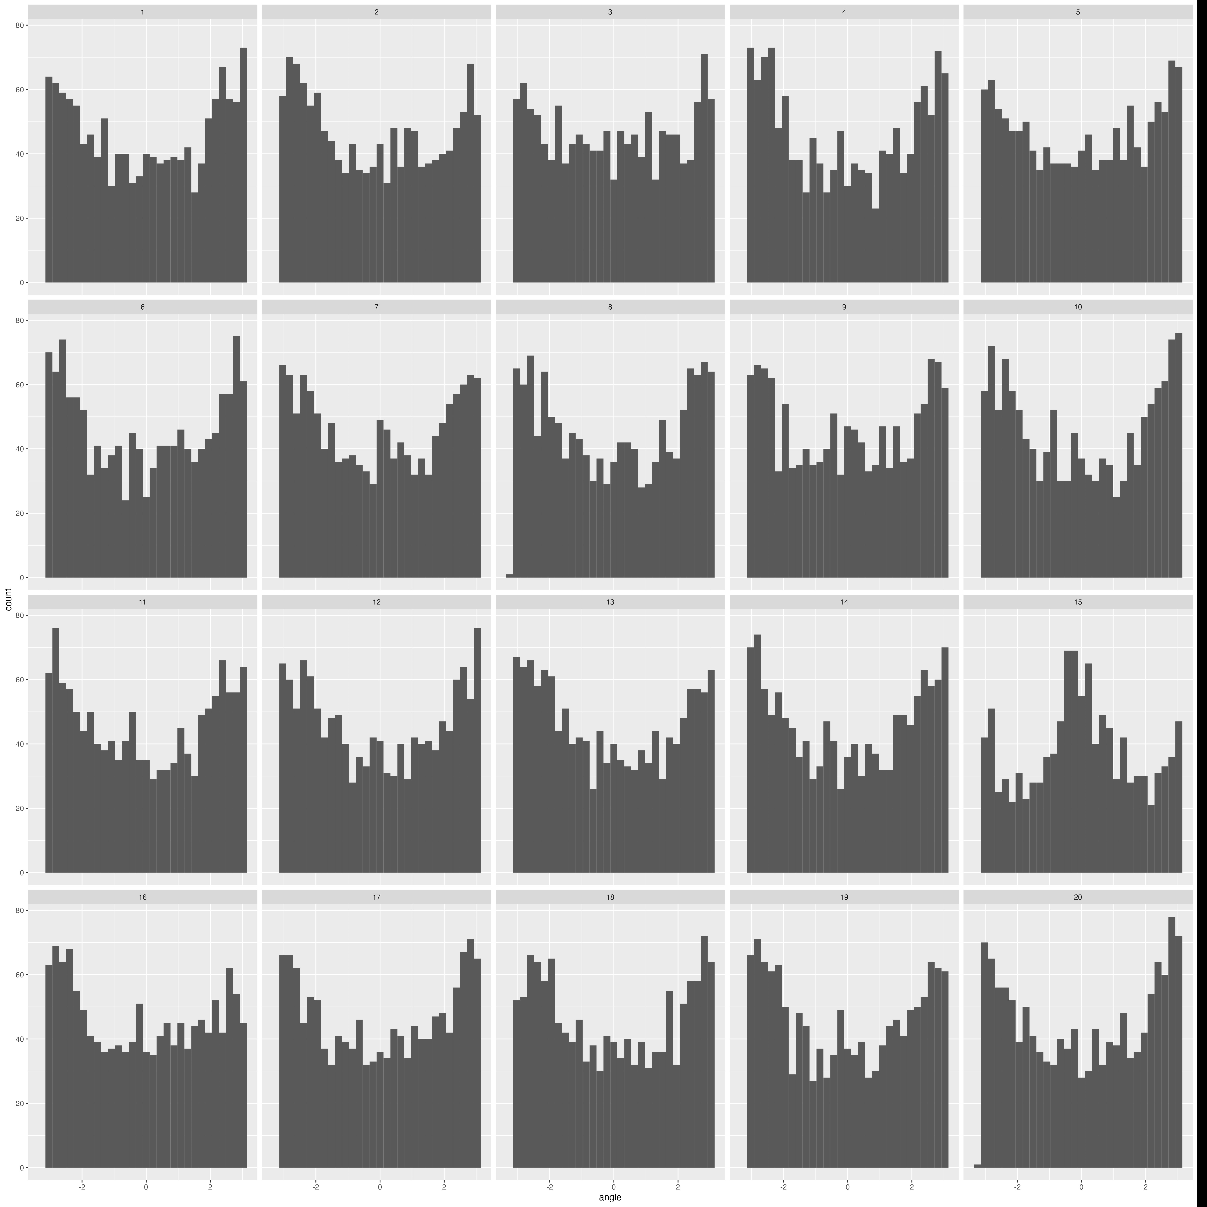
HMM
HMM
ISSA

Slide 20
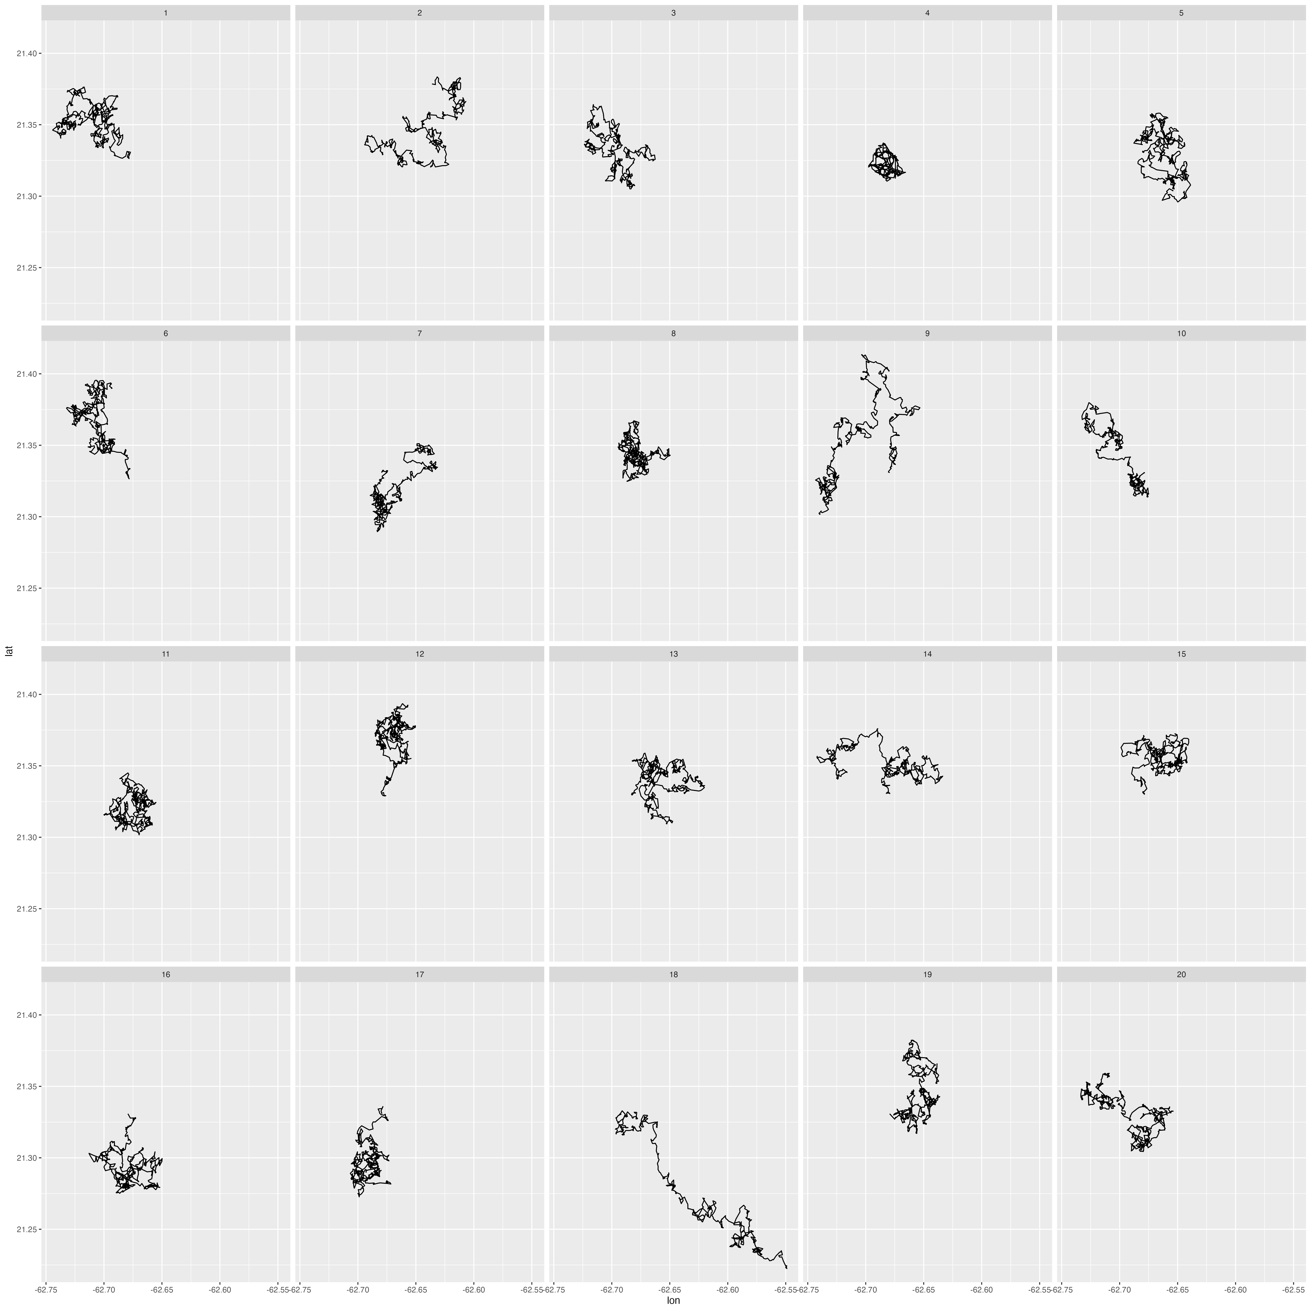
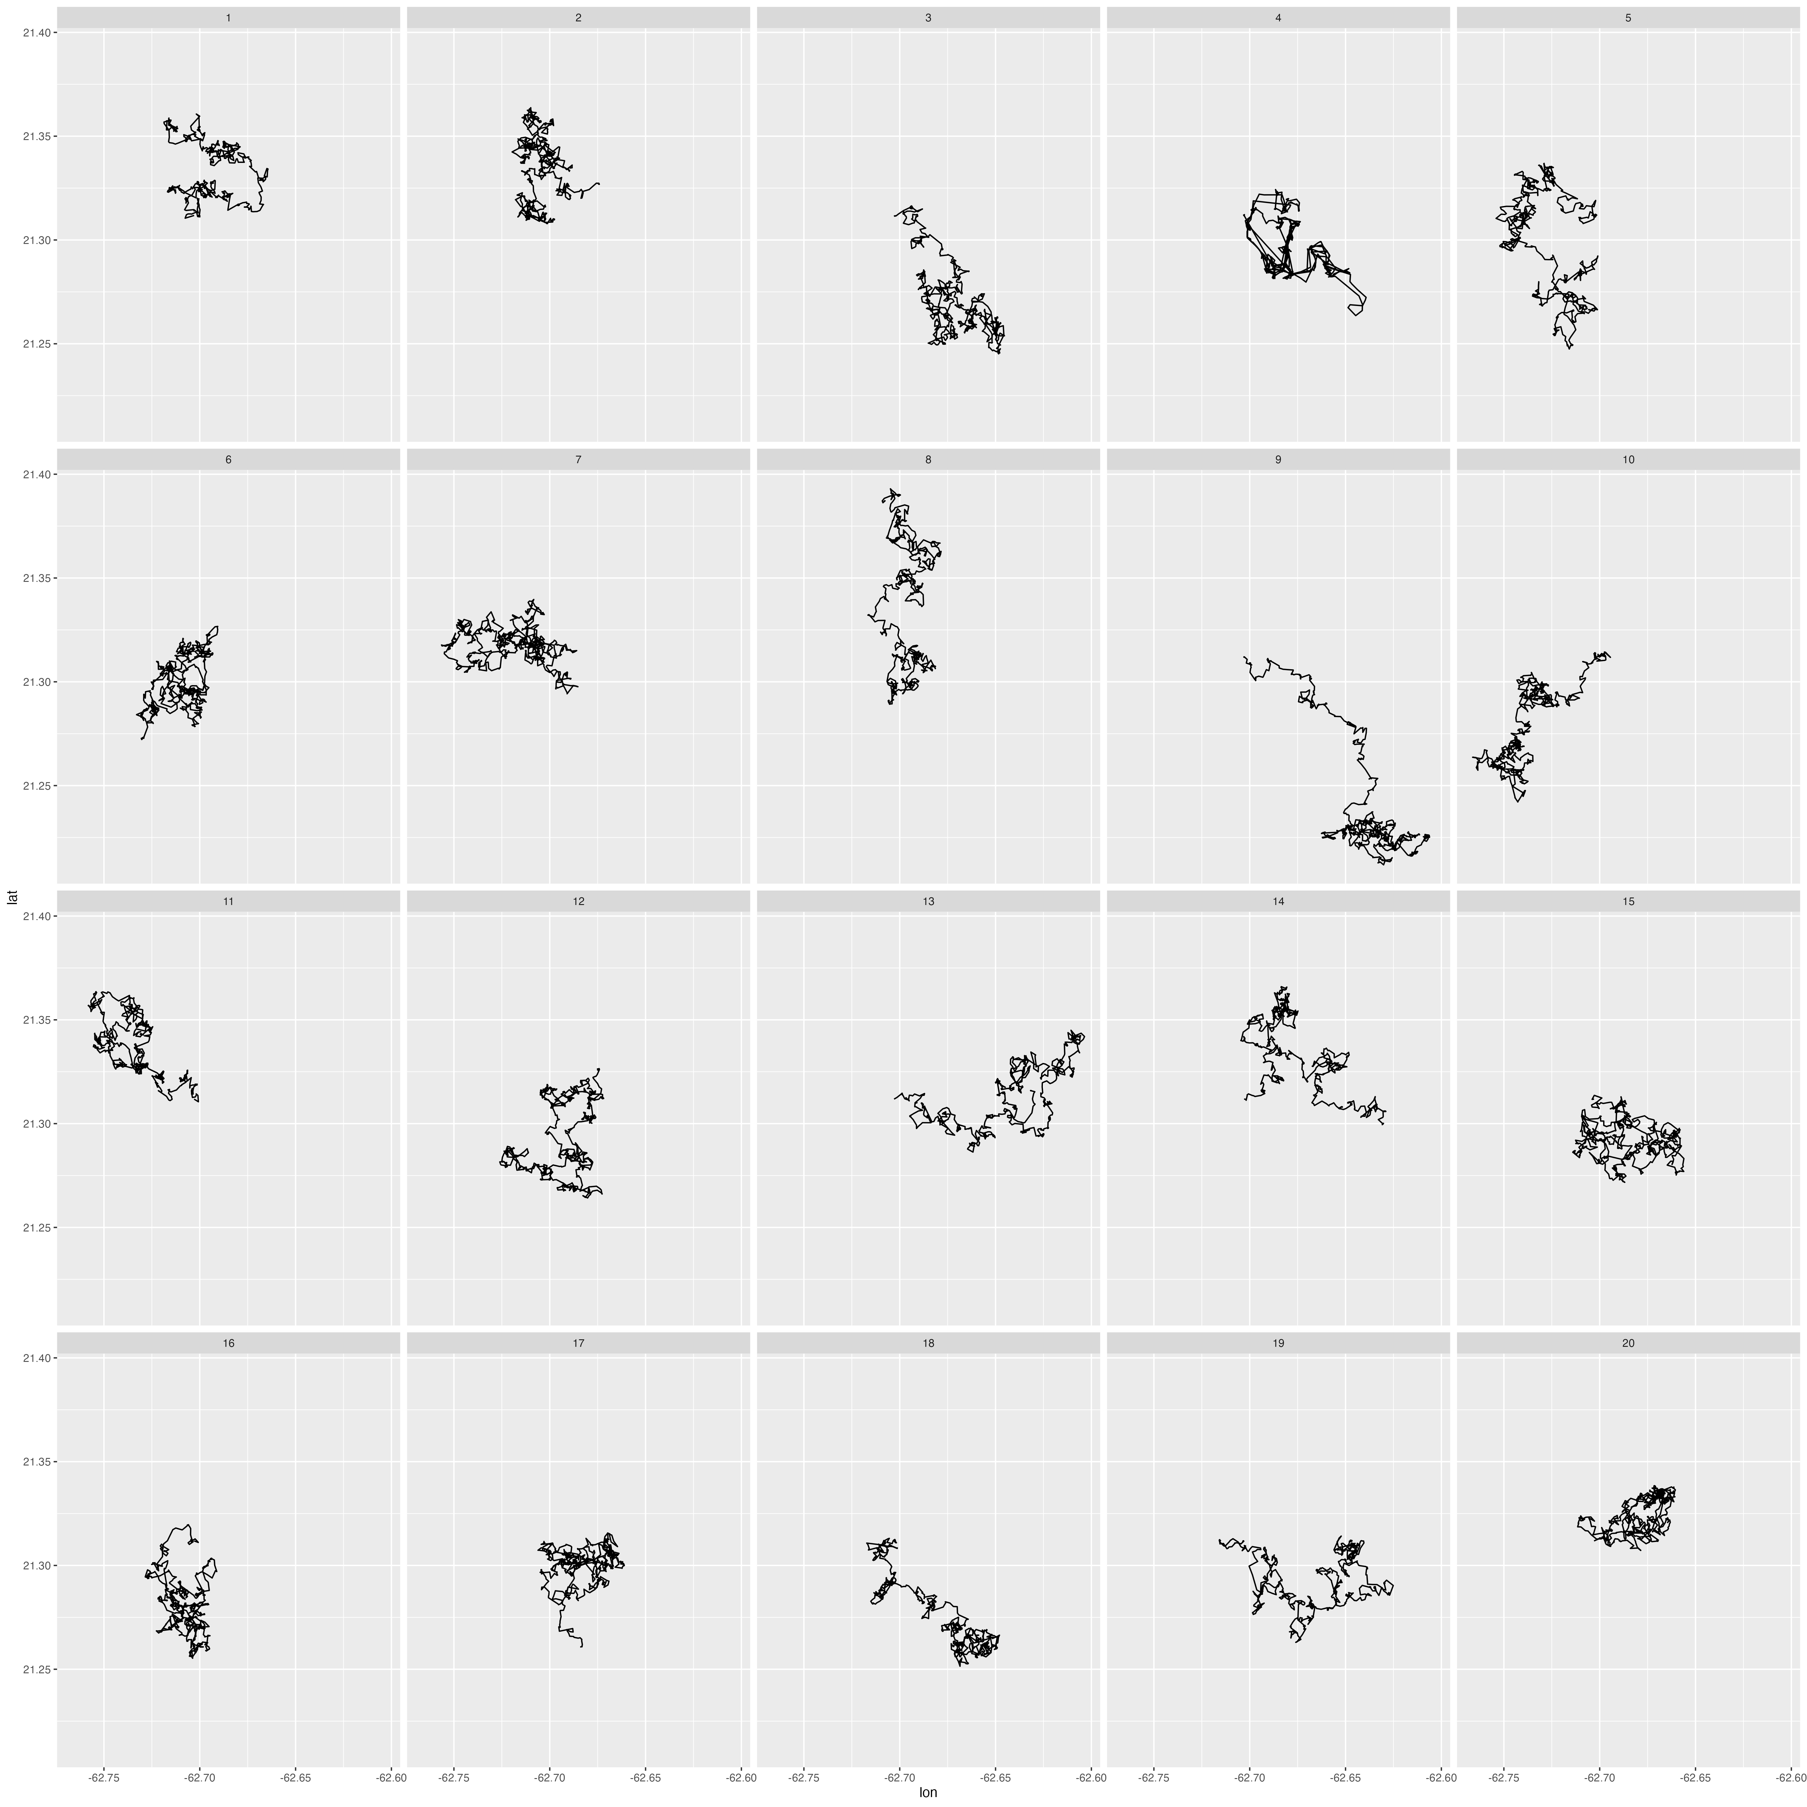
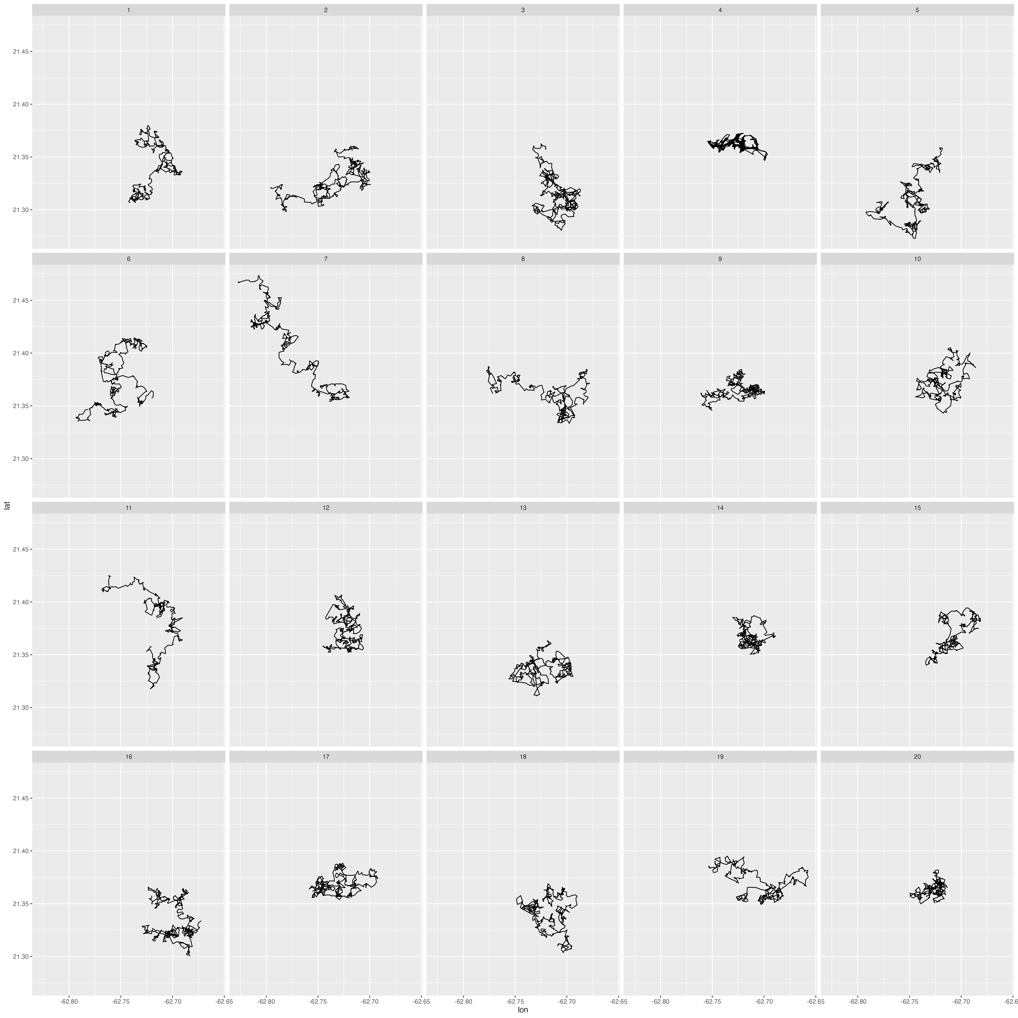
Testing With Multiple Lineups/Observers
K individual observers (each with a unique lineup)
X = number of times the observed data plot is selected
Under H₀: X ~ Binomial(K, p); p = 1/number of plots
P-value = Prob(X ≥ x)
References
Majumder, M., Hofmann, H., & Cook, D. (2013). Validation of visual statistical inference, applied to linear models. Journal of the American Statistical Association, 108(503), 942-956.
VanderPlas, S., Röttger, C., Cook, D., & Hofmann, H. (2021). Statistical significance calculations for scenarios in visual inference. Stat, 10(1), e337.
Wickham, H., Cook, D., Hofmann, H., & Buja, A. (2010). Graphical inference for infovis. IEEE Transactions on Visualization and Computer Graphics, 16(6), 973-979.

Slide 21
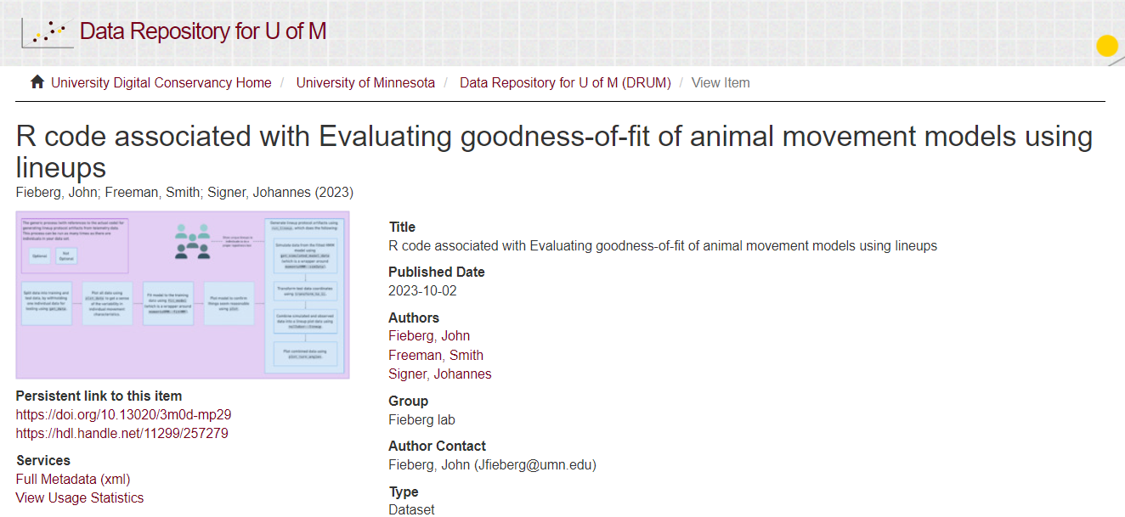

https://conservancy.umn.edu/handle/11299/257279

